Slide 1




Projecto ICTskills4All
DESIGN GOOD PRACTICES for older adults
Liliana Rodrigues | ICTskills4All Project Manager

Slide 2
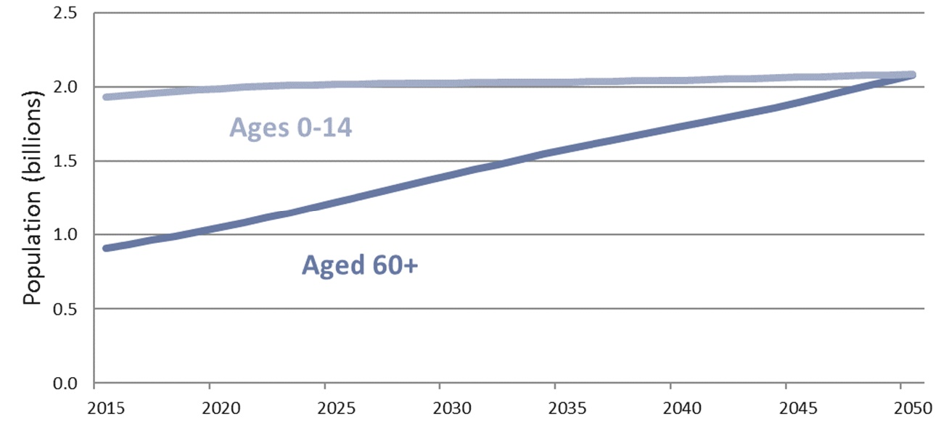
Design Good Practices for older adults
Figure 1 – The world’s younger and older populations, 2017‐2050 | United Nations – World Population Prospect – Revision 2017
Notes:
Key facts
» Between 2015 and 2050, the proportion of the world's population over 60 years will nearly double from 12% to 22%.
» By 2020, the number of people aged 60 years and older will outnumber children younger than 5 years.
» The pace of population ageing is much faster than in the past.

Slide 3
Design Good Practices for older adults
Key facts
» Between 2015 and 2050, the proportion of the world's population over 60 years will nearly double from 12% to 22%.
» By 2020, the number of people aged 60 years and older will outnumber children younger than 5 years.
» The pace of population ageing is much faster than in the past.
Ageing and Health | World Health Organization 2018

Slide 4
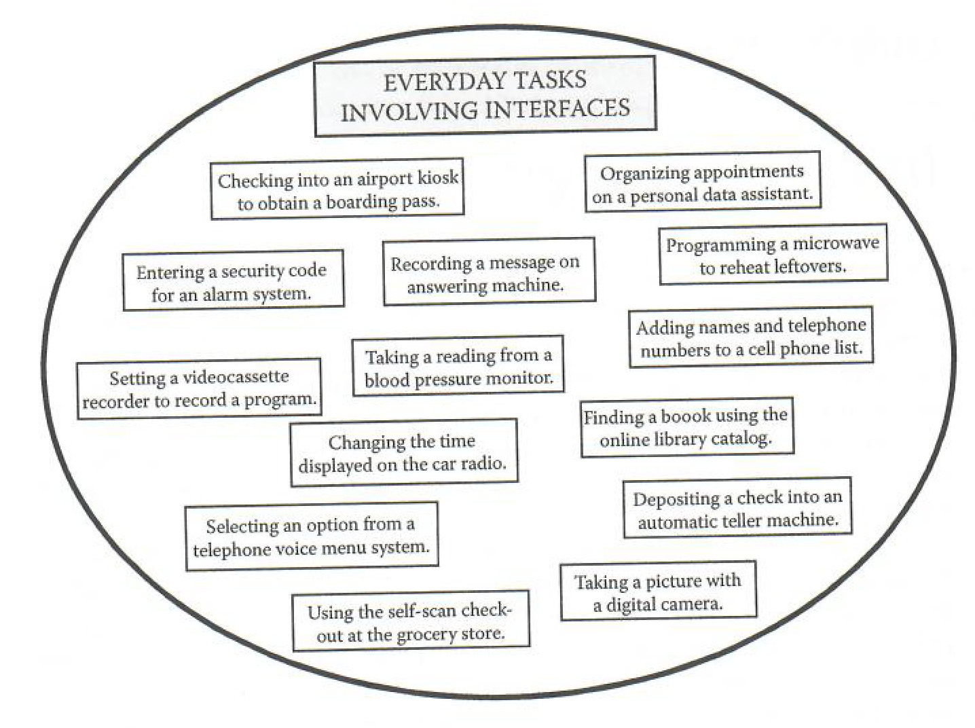
User interfaces (UI)
Figure 2 – Examples of tasks involving interfaces | Designing for Older Adults: Principles and Creative Human Factors Approaches
Notes:
Global population is rapidly ageing, and many services are now offered online, so it is necessary to design accessible user interfaces (UI) that consider senior citizens’ needs.
These needs are related to cognitive, perceptual, and psycho-motor changes that occur in the ageing process, which affect the way older people interact with digital devices. As a result, they often need support in carrying out tasks and activities.
user interface (UI) is the space where interactions between humans and machines occur

Slide 5
Impact of Ageing process in the Human Factors
Haptics
Older people tend to be less stable in movements
Audition
By the age 65 or so, 50% of all men and 30% of all women suffer hearing losses that hinders social interaction
HUMAN FACTORS
Vision
7 out of 10 people over age 45 need to wear glasses
Cognition
Age Working memory (ability to hold information) declines with age
Notes:
Haptics – related to the sense of touch. As individuals grow older, there is increasing variability in haptic control. Older people tend to be less stable in movements part due to kinesthetic sensitivity, as we age our vestibular cues deteriorate. This will have implications in design.
Audition – The ability to ear may affect one’s ability to interact successfully with systems and to function safely and effectively in environments. If audition information is an important aspect of design, age-related changes in audition must be considered. By the age 65 or so, 50% of all men and 30% of women suffer hearing losses.
Vision – The prevalence of visual impairments increases with age. Age is the single best predictor of visual limitations or blindness. If we live long enough, nearly all of us will have vison problems.
Cognition – Age-related changes in cognition are important to consider when designing for older adults.

Slide 6
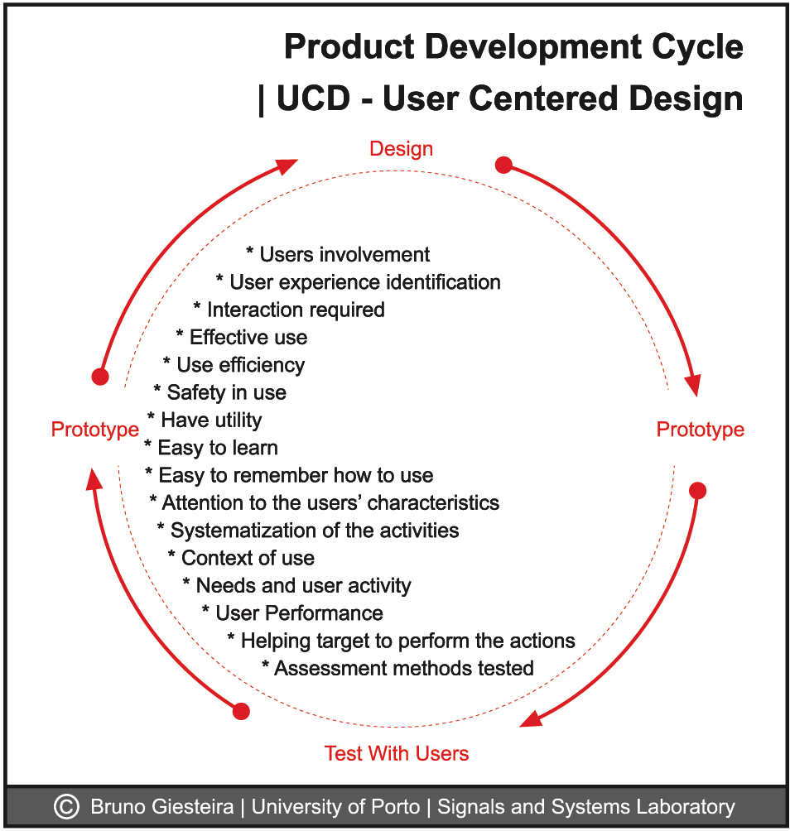

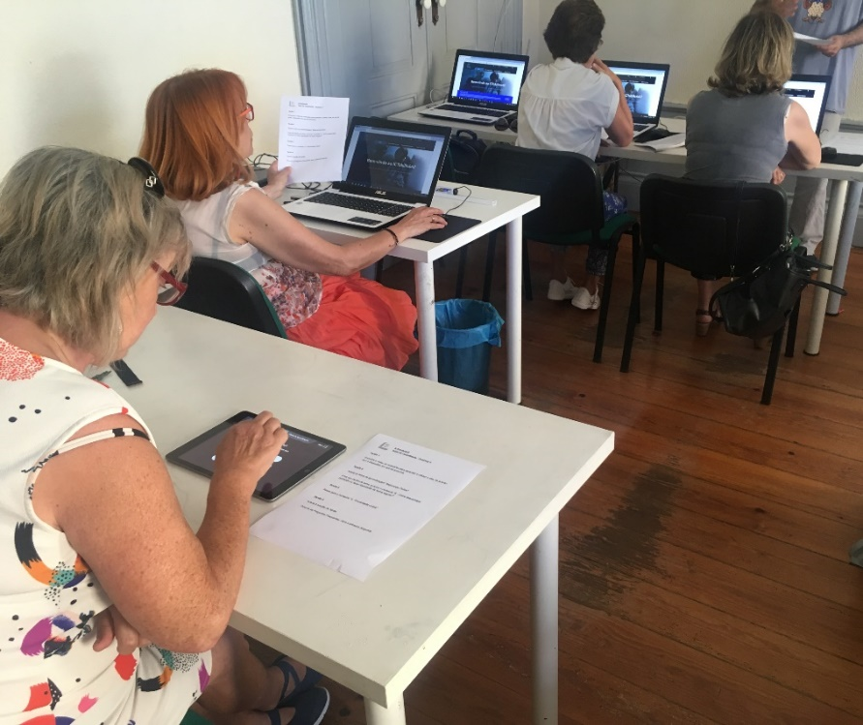
Collaborative Design – User Centered Design
Notes:
These are some of the reasons why accessibility should be part of the UI design process.
With this growing population It is of major importance that we use a collaborative design approach – User Centered Design, including the older people in the product development cycle (usability tests, card sorting, etc), and by doing so, responding to their needs and expectations.

Slide 7
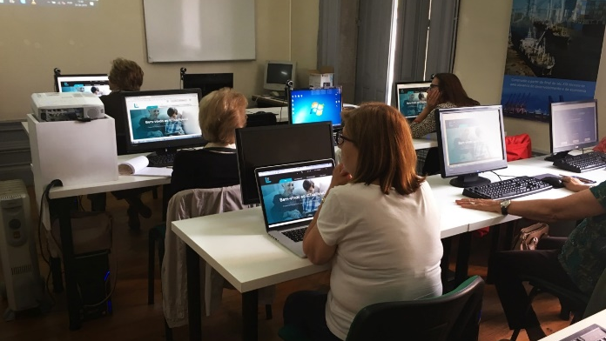
Notes:
This is one example of an usability test, done in the middle of the project website development cycle. This usability tests made with end users helped us to gather valuable information allowing us to improve the website interface.

Slide 8
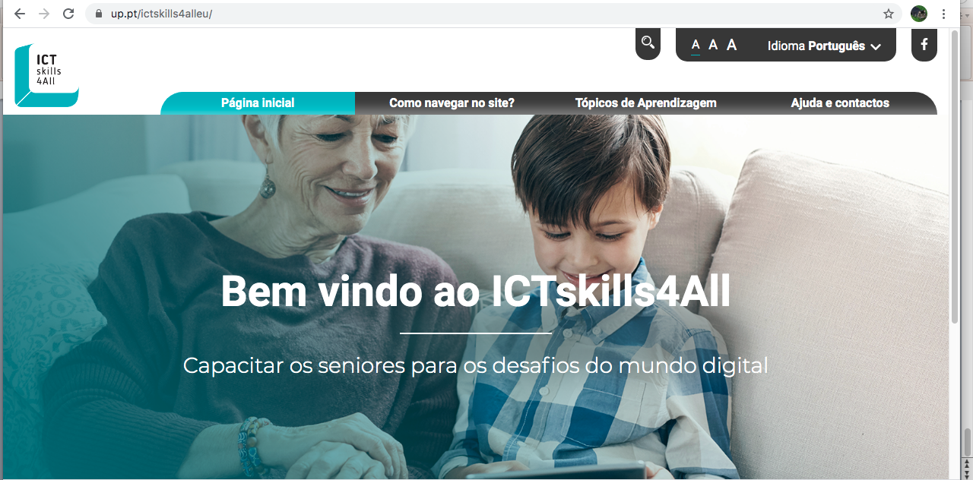
Notes:
After working with a focus group so that we could understand what their expectations were, we developed a prototype, and tested it with usability tests. After giving the users the task of making a search, almost all users needed assistance to do so because the magnifying glass icon alone was not enough.
We used the think aloud method that allows users to talk, make suggestions on how we can improve. The users suggested that we put the word search in front of the magnifying glass icon to make it easier. This is just one of the several examples of an iterative development that count with a closer relation with older people.

Slide 9
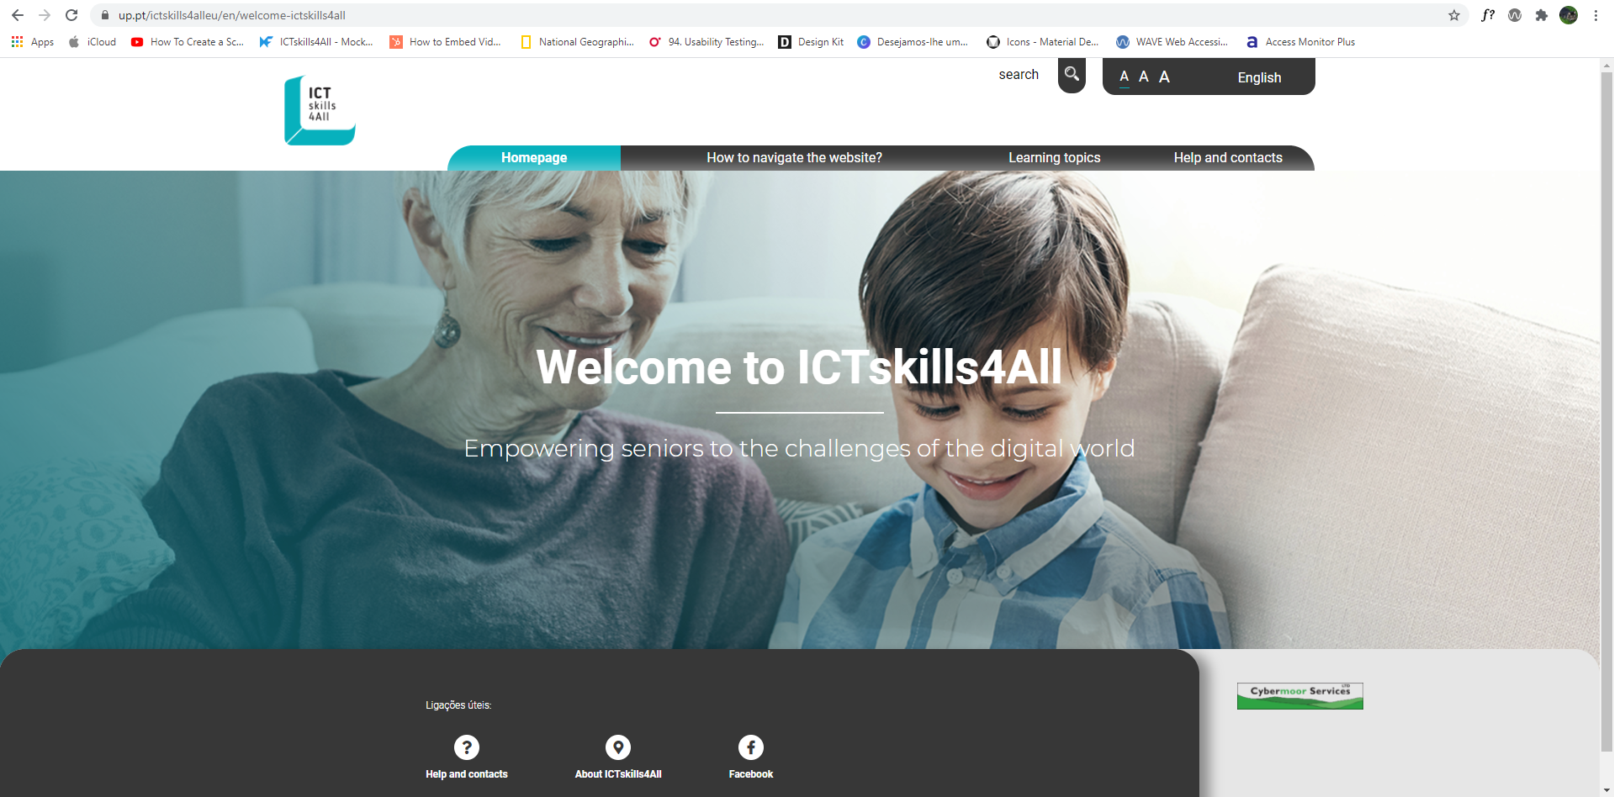
Notes:
These are some of the reasons why accessibility should be part of the UI design process, taking a collaborative user-centered design approach (User Centered Design) including the elderly in the product development cycle (usability tests), and responding to their needs and expectations.

Slide 10
Design Good Practices for older adults
Design frameworks
=
interaction framework +
visual framework
Interaction framework = principles of interaction design and patterns
Visual framework = color, typography, icons, assets
Notes:
Some concepts are particularly relevant to safeguard the inclusiveness of an interactive artifact. This is the case of the Design framework in which details some of the most important interaction design principles as well as interaction patterns.
Is the example of the search icon that I have mentioned and other principles and components that take part of the interface for the correct use of colors, to a legible typography, even to those who have vision deficits to icons that should be related to the cultural background and digital literacy of these users.
Well we have taken that into account.

Slide 11
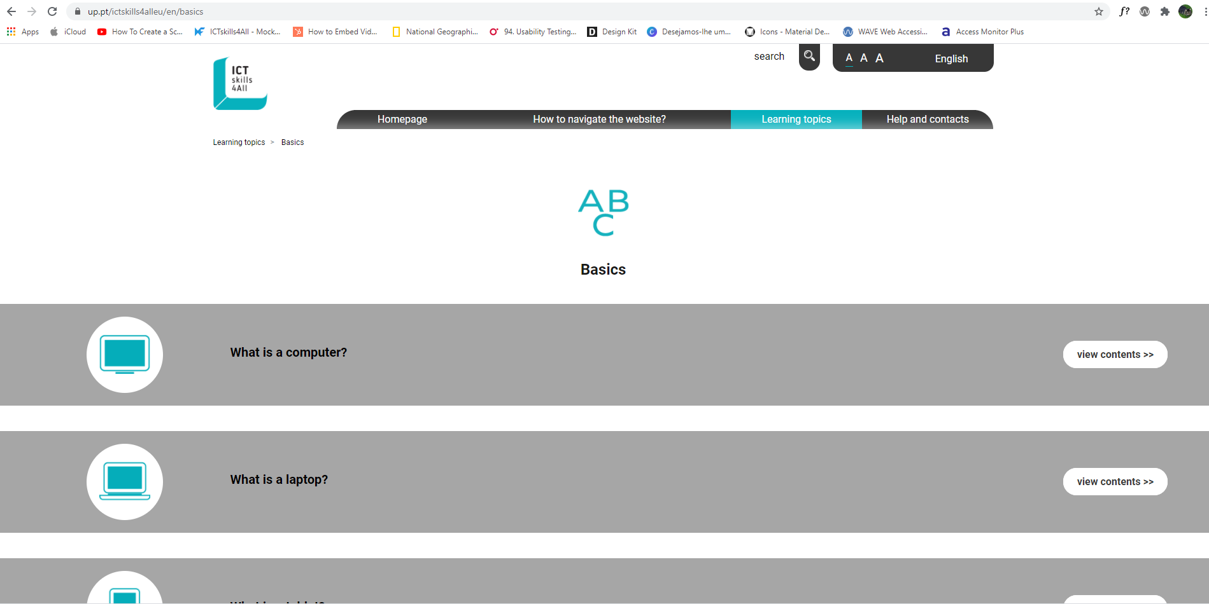
Design Good Practices for older adults
» Menu - Should be simple
» Text - Bigger Font size
Notes:
Our visual framework deems to be inclusive, accessible, oriented by the good practices for the older people.
» Menu – Should be simple.
» Text - Older people prefer a bigger font size that allows them to better perceive.

Slide 12
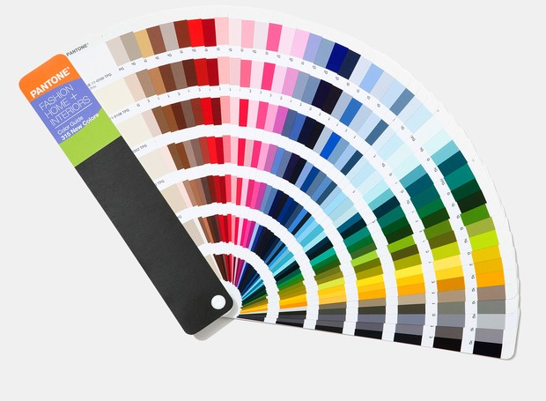
» Colors in the screen should have a high contrast between the foreground and the background and should be conservative.
Notes:
» Colors in the screen should have a high contrast between the foreground and the background and should be conservative. Conservative colors are black, white, grey, blue, beige, and various shades, tones, or tints of these colors. As well as any color palette with a mix of neutral and highlight colors, where the neutral color appears in the biggest amount.

Slide 13
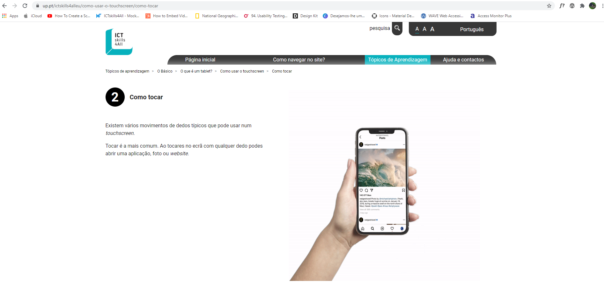
Design Good Practices for older adults
» Keypad - Buttons play an important role in age-specific UI design.
» Buttons - should not be too sensitive
» Touchscreen - The touch technology in mobile device creates difficulties for older people.
Notes:
» Keypad - Buttons play an important role in age-specific UI design. Older people prefer large buttons with clear and immediate feedback (visual, tactile, and/or auditory) that helps them avoid mistakes when pressing a button.
» Buttons should not be too sensitive, and they should be visually differentiated from other actionable elements.
» Touchscreen - The touch technology in mobile device creates difficulties for older people. They are not familiarized with tapping on the screen, so they need more time to comprehend and learn gestures. It is highly recommended to keep gestures simple. It is suggested to include auditory and tactile signals that give distinctive feedback to the user.

Slide 14
THANK YOU
For further clarifications please contact through lsrodrigues@reit.up.pt

